Slide 1
Data for Pressure Head (3.5mm) Validation
➔ Used 8mm and 3.5 mm pressure head two measure hardness of Apples
➔ 5 Apples ( 2 samples from each)
8mm Tip | 3.5 mm Tip
 | Without Correction | With Correction (*5.22)
9.8 | 1.8 | 9.396
10 | 1.8 | 9.396
10.2 | 1.8 | 9.396
9.5 | 1.8 | 9.396
9 | 1.6 | 8.352
8.5 | 1.6 | 8.352
6.5 | 1.2 | 6.264
7 | 1.5 | 7.83
6.5 | 1.4 | 7.308
7.5 | 1.5 | 7.83

Slide 2
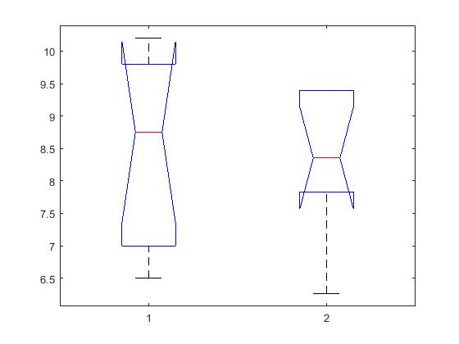
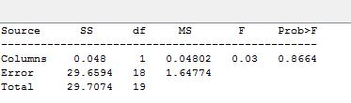
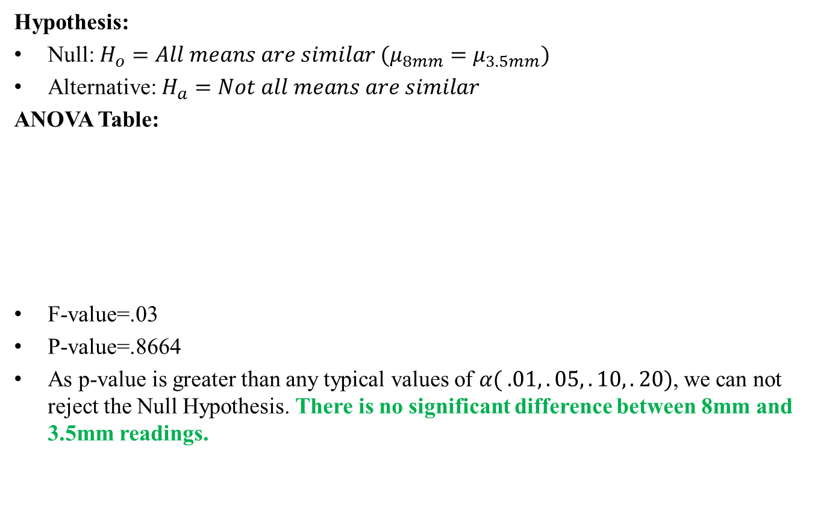
ANOVA (Single Factor)
Hypothesis:
Null: $H_{o}=All means are similar (μ_{8mm}=μ_{3.5mm})$
Alternative: $H_{a}=Not all means are similar$
ANOVA Table:
F-value=.03
P-value=.8664
As p-value is greater than any typical values of $α( .01,.05,.10,.20)$, we can not reject the Null Hypothesis. There is no significant difference between 8mm and 3.5mm readings.

Slide 3
Chewing Strength Study
Recruited 4 participants.
10 bites from three participants, 9 bites from one participant. Total 39 bites.
Took hardness using penetrometer (3.5mm for carrot, 8mm for Apple and 11mm for Banana) before serving.
Subject 1: Apple, Banana, Carrot
Subject 2: Banana, Apple, carrot
Subject 3: Carrot, Banana, Apple
Subject 4: Carrot, Apple, Banana

Slide 4
Hardness Measurement
Day | Subject ID | Apple |  |  | Carrot |  |  | Banana 1 |  | Banana 2
 |  | Reading 1 | Reading 2 | Reading 3 | Reading 1 | Reading 2 | Reading 3 | Reading 1 | Reading 2
 |  |  |  |  |  |  |  |  |  | Reading 1 | Reading 2
Day-1 | Sub-1 | 8.2 | 7.8 | 8.4 | 38.6 | 37.58 | 35.5 | 1.4 | 1.2 | 1.5 | 1.8
 |  | 8.133±.3055 |  |  | 36.6267±. 1.7147 |  |  | 1.3000±. 0.1414 |  | 1.65±. .2121
 | Sub-2 | 7.6 | 8 | 8.2 | 37.58 | 33.93 | 38.63 | 1.2 | 1.5 | 1.2 | 1.4
 |  | 7.9333±.3055 |  |  | 36.1133±. 2.3677 |  |  | 1.3500±. 0.2121 |  | 1.3±. .1414
Day-2 | Sub-3 | 7.4 | 7.8 | 7.6 | 36.54 | 37.58 | 36.54 | 1 | .8 | 1.2 | .9
 |  | 7.6000±. 0.2000 |  |  | 36.8867±. 0.6004 |  |  | 0.9000±. 0.1414 |  | 1.05±. .2121
 | Sub-4 | 7.5 | 7.2 | 7.8 | 36.496 | 33.408 | 39.15 | .8 | 1.2 | .9 | 1
 |  | 7.5000±. 0.3000 |  |  | 36.3513±. 2.8737 |  |  | 1±. .2828 |  | .95±. 0707

Slide 5
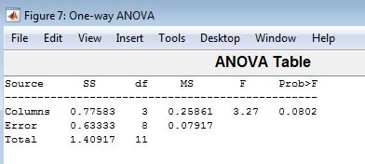
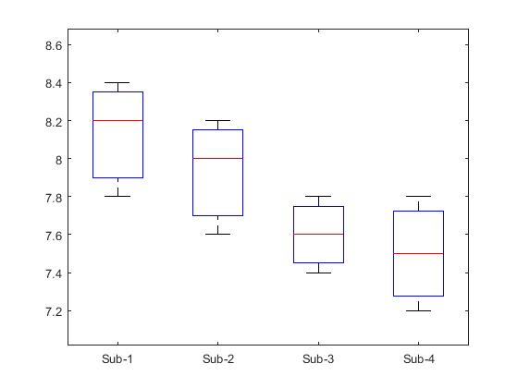
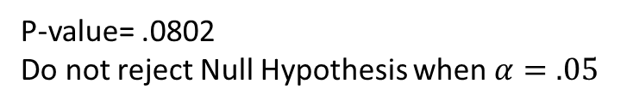
ANOVA Analysis for measured Hardness (Apple)
Null Hypothesis: No variation of hardness within subjects for apple
Alternative Hypothesis: variation of hardness within subjects for apple
P-value= .0802
Do not reject Null Hypothesis when $α=.05$
With 95% confidence, there is enough evidence, that there is no significant variation of hardness of Apples served to the subjects

Slide 6
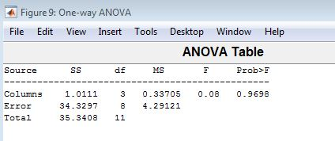
ANOVA Analysis for measured Hardness (Carrot)
Null Hypothesis: No variation of hardness within subjects for carrot
Alternative Hypothesis: variation of hardness within subjects for carrot
P-value= .9698
Do not reject Null Hypothesis when $α=any typical values (.01,.05,.10)$
With 95% confidence, there is enough evidence, that there is no significant variation of hardness of Carrot served to the subjects

Slide 7
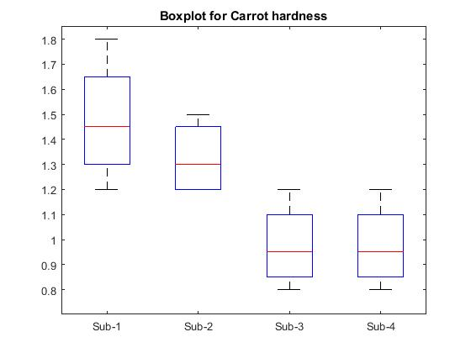
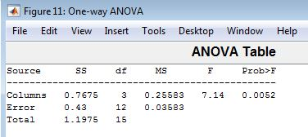
ANOVA Analysis for measured Hardness (Banana)
Null Hypothesis: No variation of hardness within subjects for banana
Alternative Hypothesis: variation of hardness within subjects for banana
P-value= .0052
reject Null Hypothesis when $α=any typical values (.01,.05,.10)$
With 95% confidence, there is enough evidence, that there is significant variation of hardness of banana served to the subjects

Slide 8
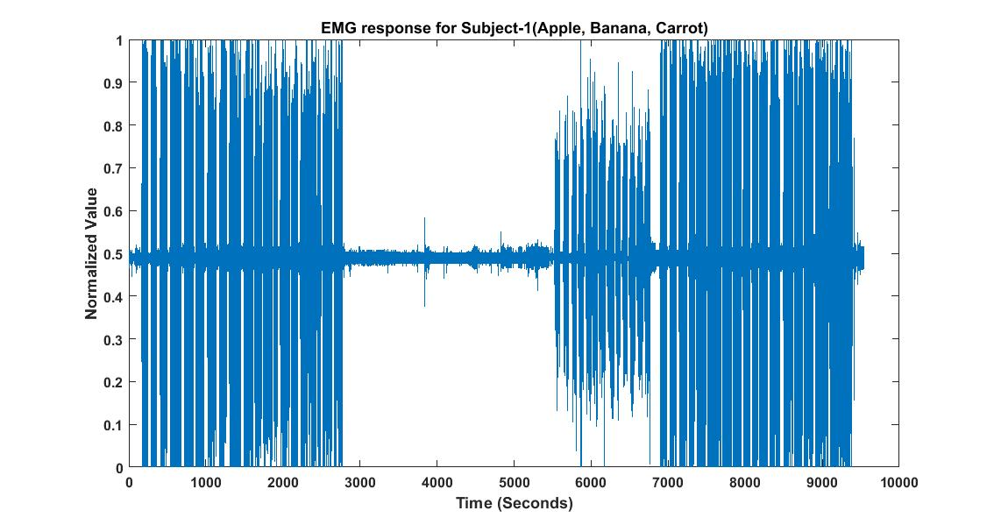
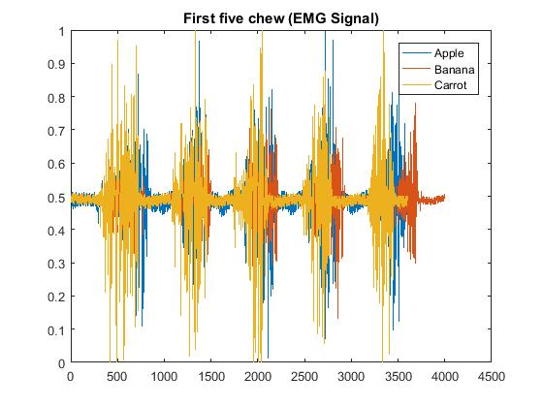
EMG Sensor
Signal was normalized between [0,1]
First 5 chews of each bite for different food was truncated
39 bites from 4 participant.
Total Observation ( standard deviation)=39
Comparison:
1. Carrot and Apple
2. Carrot and Banana
3. Apple and Banana
Figure: Normalized EMG response
Figure: Truncated first five chews for a bite

Slide 9
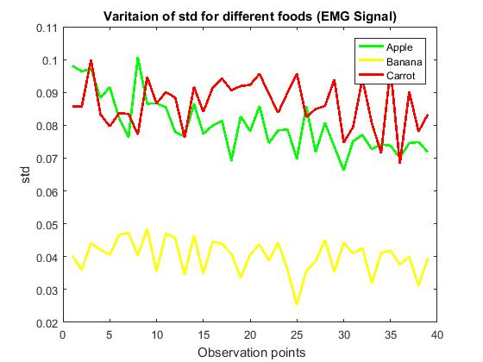
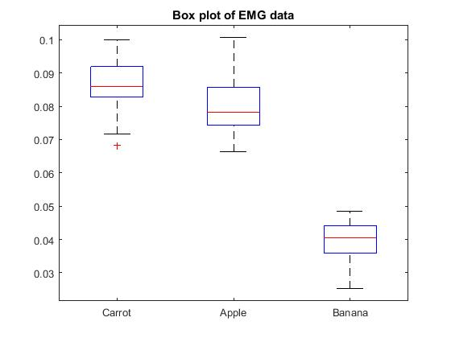
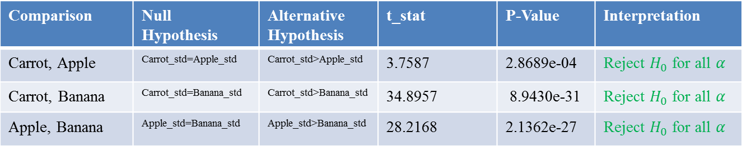
EMG Test
1. Test between Carrot and Apple
Null Hypothesis: Standard deviation for carrot and apple is same
Alternative: Carrot has higher standard deviation than apple.
Figure: standard deviation for different food
Figure: Box plot of standard deviation for different food
Comparison | Null Hypothesis | Alternative Hypothesis | t_stat | P-Value | Interpretation
Carrot, Apple | Carrot_std=Apple_std | Carrot_std>Apple_std | 3.7587 | 2.8689e-04 | Reject $H_{0}$ for all $α$
Carrot, Banana | Carrot_std=Banana_std | Carrot_std>Banana_std | 34.8957 | 8.9430e-31 | Reject $H_{0}$ for all $α$
Apple, Banana | Apple_std=Banana_std | Apple_std>Banana_std | 28.2168 | 2.1362e-27 | Reject $H_{0}$ for all $α$
Enough evidence for all $α$, Carrot_std>Apple_std>Banana_std

Slide 10
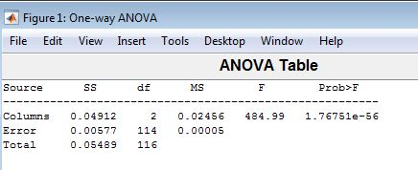
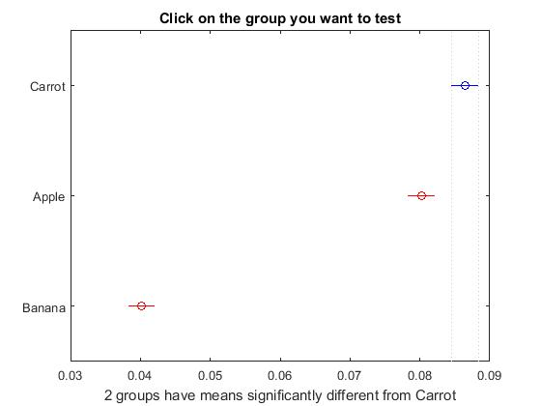
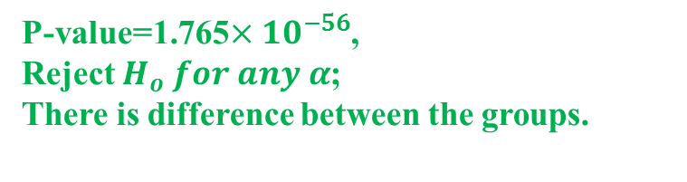
EMG ANOVA Analysis
Null Hypothesis: Mean of standard deviation is equal for each fruit
Alternative: At least one mean are different
P-value=1.765$×{10}^{−56}$,
Reject $H_{o} for any α$;
There is difference between the groups.
So we can perform multiple comparison( kramer-tukey) test to find which group differs
Group1 | Group2 | Lower bound of CI | Mean difference | Upper bound of CI | P-value
Carrot | Apple | 0.0024 | 0.0062 | .0100 | 0.0006
Carrot | Banana | 0.0424 | 0.0462 | 0.0501 | 0.0000
Apple | Banana | 0.0362 | 0.0400 | 0.0439 | 0.0000
P-values are small (less than .01) . Confidence interval do not include zero, also both lower bound and upper bound is positive
Enough evidence to deduce Carrot_std>Apple_std>Banana_std

Slide 11
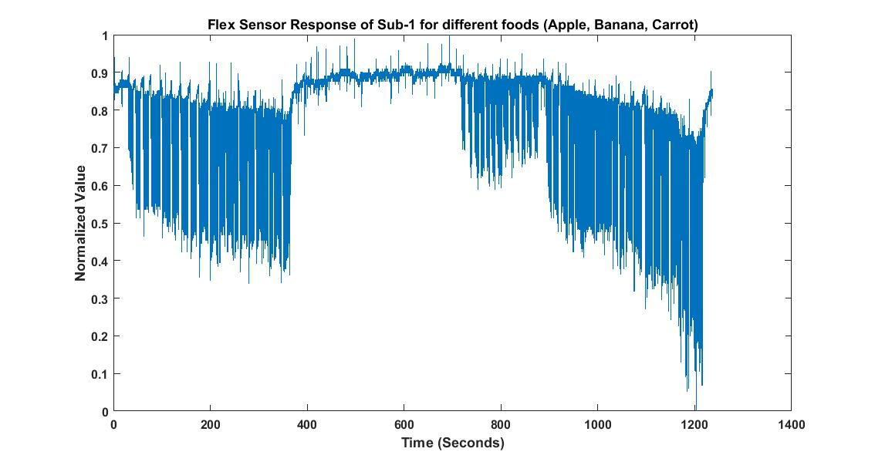
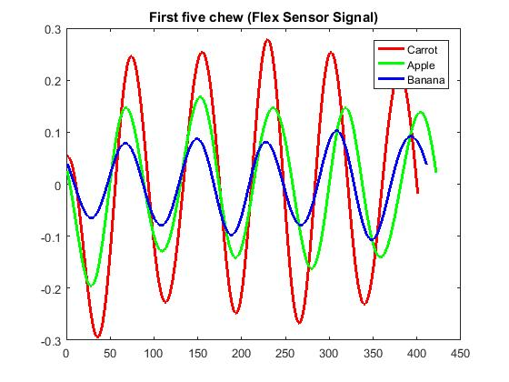
Flex Sensor
Signal was normalized between [0,1]
First 5 chews of each bite for different food was truncated
39 bites from 4 participant.
Total Observation ( standard deviation)=39
Comparison:
1. Carrot and Apple
2. Carrot and Banana
3. Apple and Banana
Figure: Normalized flex sensor response
Figure: Truncated first five chews for a bite

Slide 12
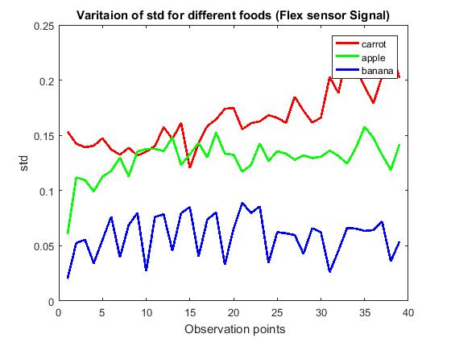
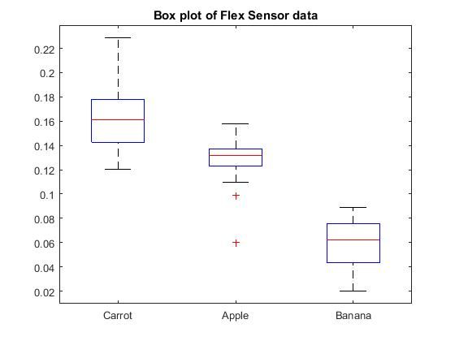
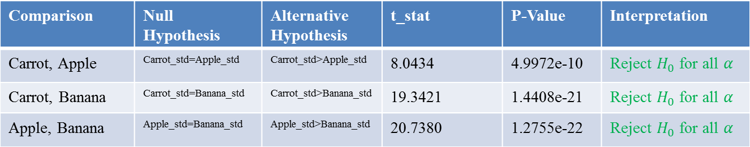
Flex Sensor Test
1. Test between Carrot and Apple
Null Hypothesis: Standard deviation for carrot and apple is same
Alternative: Carrot has higher standard deviation than apple.
Figure: standard deviation for different food
Figure: Box plot of standard deviations for different food
Comparison | Null Hypothesis | Alternative Hypothesis | t_stat | P-Value | Interpretation
Carrot, Apple | Carrot_std=Apple_std | Carrot_std>Apple_std | 8.0434 | 4.9972e-10 | Reject $H_{0}$ for all $α$
Carrot, Banana | Carrot_std=Banana_std | Carrot_std>Banana_std | 19.3421 | 1.4408e-21 | Reject $H_{0}$ for all $α$
Apple, Banana | Apple_std=Banana_std | Apple_std>Banana_std | 20.7380 | 1.2755e-22 | Reject $H_{0}$ for all $α$
Enough evidence for all $α$, Carrot_std>Apple_std>Banana_std

Slide 13
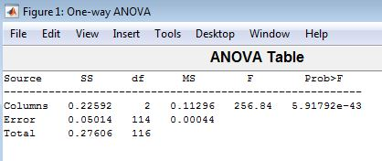
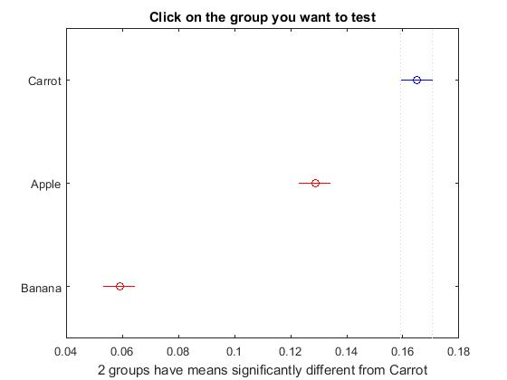
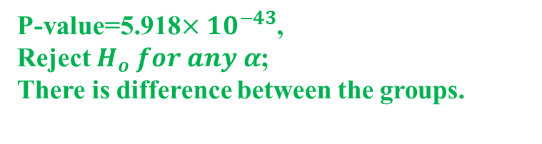
Flex ANOVA Analysis
Null Hypothesis: Mean of standard deviation is equal for each fruit
Alternative: At least one mean are different
P-value=5.918$×{10}^{−43}$,
Reject $H_{o} for any α$;
There is difference between the groups.
So we can perform multiple comparison( kramer-tukey) test to find which group differs
Group1 | Group2 | Lower bound of CI | Mean difference | Upper bound of CI | P-value
Carrot | Apple | 0.0248 | 0.0361 | .0474 | 0.0000
Carrot | Banana | 0.0946 | 0.1059 | 0.1171 | 0.0000
Apple | Banana | 0.0585 | 0.0698 | 0.0811 | 0.0000
P-values are small (less than .01) . Confidence interval do not include zero, also both lower bound and upper bound is positive
Enough evidence to deduce Carrot_std>Apple_std>Banana_std

Slide 14
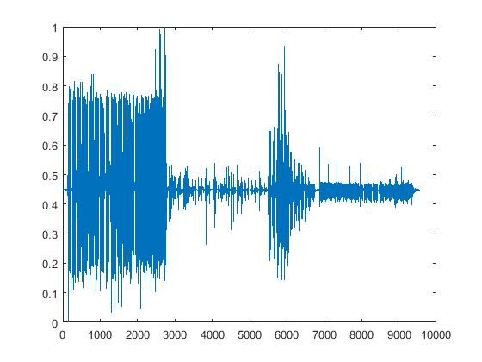
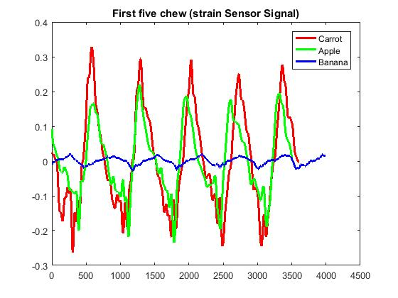
Strain Sensor
Signal was normalized between [0,1]
First 5 chews of each bite for different food was truncated
39 bites from 4 participant.
Total Observation ( standard deviation)=39
Comparison:
1. Carrot and Apple
2. Carrot and Banana
3. Apple and Banana
Figure: Normalized strain sensor response
Figure: Truncated first five chews for a bite

Slide 15
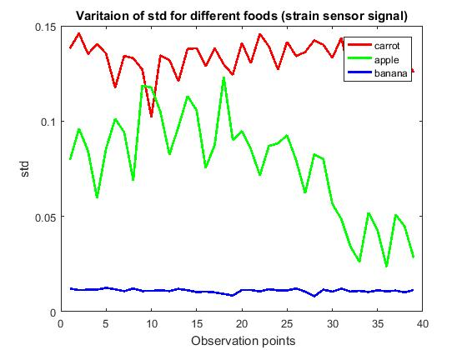
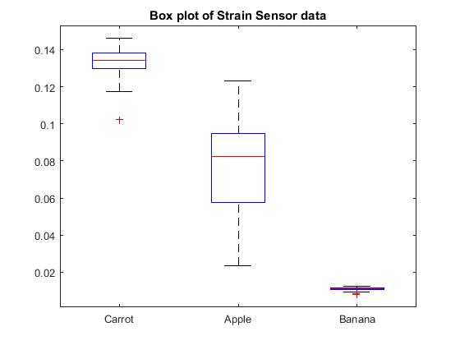

Strain Sensor Test
1. Test between Carrot and Apple
Null Hypothesis: Standard deviation for carrot and apple is same
Alternative: Carrot has higher standard deviation than apple.
Figure: standard deviation for different food
Figure: Box plot of standard deviations for different food
Comparison | Null Hypothesis | Alternative Hypothesis | t_stat | P-Value | Interpretation
Carrot, Apple | Carrot_std=Apple_std | Carrot_std>Apple_std | 12.2150 | 4.9718e-15 | Reject $H_{0}$ for all $α$
Carrot, Banana | Carrot_std=Banana_std | Carrot_std>Banana_std | 91.3622 | 1.8984e-46 | Reject $H_{0}$ for all $α$
Apple, Banana | Apple_std=Banana_std | Apple_std>Banana_std | 15.6734 | 1.7808e-18 | Reject $H_{0}$ for all $α$
Enough evidence for all $α$, Carrot_std>Apple_std>Banana_std

Slide 16
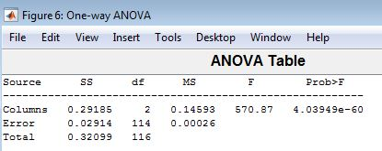
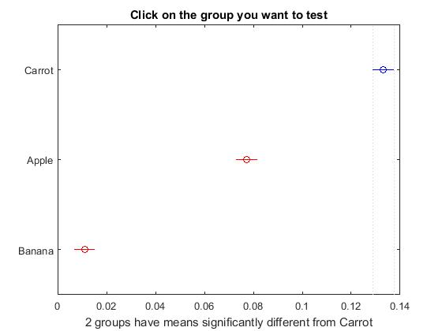
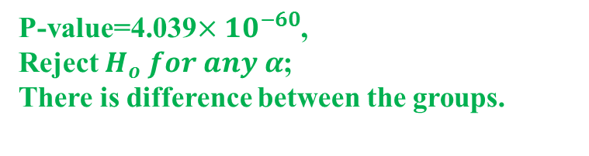
Strain ANOVA Analysis
Null Hypothesis: Mean of standard deviation is equal for each fruit
Alternative: At least one mean are different
P-value=4.039$×{10}^{−60}$,
Reject $H_{o} for any α$;
There is difference between the groups.
So we can perform multiple comparison( kramer-tukey) test to find which group differs
Group1 | Group2 | Lower bound of CI | Mean difference | Upper bound of CI | P-value
Carrot | Apple | 0.0472 | 0.0558 | .0644 | 0.0000
Carrot | Banana | 0.1136 | 0.1222 | 0.1308 | 0.0000
Apple | Banana | 0.0578 | 0.0664 | 0.0750 | 0.0000
P-values are small (less than .01) . Confidence interval do not include zero, also both lower bound and upper bound is positive
Enough evidence to deduce Carrot_std>Apple_std>Banana_std

Slide 17
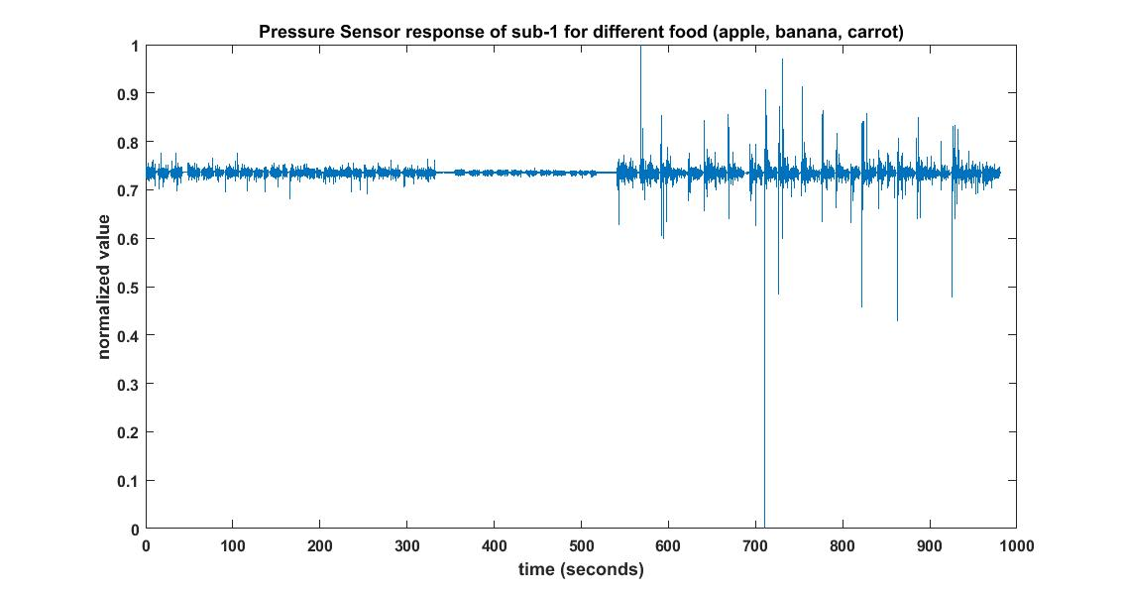
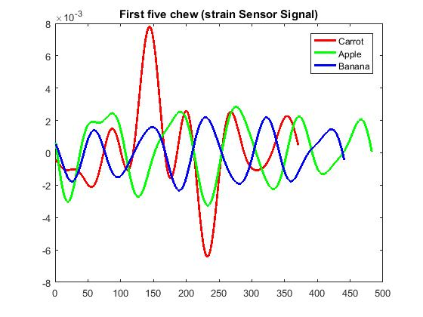
Pressure Sensor
Signal was normalized between [0,1]
First 5 chews of each bite for different food was truncated
39 bites from 4 participant.
Total Observation ( standard deviation)=39
Comparison:
1. Carrot and Apple
2. Carrot and Banana
3. Apple and Banana
Figure: Normalized pressure sensor response
Figure: Truncated first five chews for a bite

Slide 18
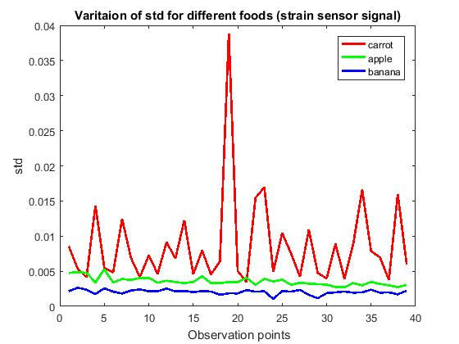
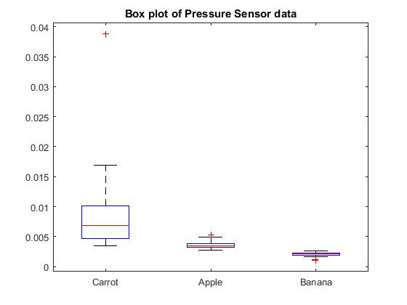

Pressure Sensor Test
1. Test between Carrot and Apple
Null Hypothesis: Standard deviation for carrot and apple is same
Alternative: Carrot has higher standard deviation than apple.
Figure: standard deviation for different food
Figure: Box plot of standard deviations for different food
Comparison | Null Hypothesis | Alternative Hypothesis | t_stat | P-Value | Interpretation
Carrot, Apple | Carrot_std=Apple_std | Carrot_std>Apple_std | 4.8895 | 9.3683e-06 | Reject $H_{0}$ for all $α$
Carrot, Banana | Carrot_std=Banana_std | Carrot_std>Banana_std | 6.4007 | 8.0414e-08 | Reject $H_{0}$ for all $α$
Apple, Banana | Apple_std=Banana_std | Apple_std>Banana_std | 17.8399 | 2.3101e-20 | Reject $H_{0}$ for all $α$
Enough evidence for all $α$, Carrot_std>Apple_std>Banana_std

